Slide 1
Fighting Pandemics and Building a Healthier, More Equitable World
Overview of the New Global Fund Strategy
[Insert Meeting Name]
[Insert Date]
March 2022

Slide 2


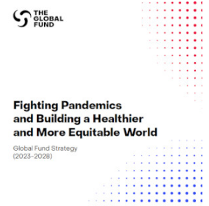



Background
Our Progress
Where we are now
Our Future
As of end 2020:
We are off track to meet the Sustainable Development Goal (SDG) 3 targets.
New Global Fund Strategy
to accelerate impact toward the 2030 horizon.
44
million
lives saved
21.9 million people on antiretroviral therapy for HIV in 2020
4.7 million people with TB treated in 2020
188 million mosquito nets distributed in 2020
Notes:
The Global Fund partnership has achieved incredible results to date in the fight against HIV, TB and malaria (HTM) and in contributing to better health in countries where it supports programs – with more than 44 million lives saved to date.
However, the world is off-track to meet the 2030 SDG goals and in the rapidly evolving global health context with a new pandemic, a new Global Fund Strategy is needed to guide our collective efforts to get back on track.
The new Global Fund Strategy “Fighting Pandemics and Building a Healthier, More Equitable World” does just this. It was developed through a highly consultative process and sets out how the Global Fund partnership can work together to accelerate impact towards the 2030 horizon.

Slide 3

High-level Features of the New Strategy
Strategy
Vision
“A world free of the burden of AIDS, tuberculosis and malaria with better, equitable health for all.”
The Strategy’s impact will be measured in 2030 alongside the SDGs.
2023 | 2024 | 2025 | 2026 | 2027 | 2028 | 2029 | 2030
Global Fund Strategy: Fighting Pandemics and Building a Healthier and More Equitable World
 | Grant Implementation |  |  | Grant Implementation
 |  | Impact Measurement |  |  | Impact Measurement
2030 SDG Measurement
Notes:
The Strategy’s vision is a world free of the burden of AIDS, tuberculosis and malaria with better, equitable health for all.
The word equitable was added to the Global Fund’s vision for this period to underscore the partnership’s commitment to addressing inequities in order to achieve our goals.
The new Strategy will guide the Global Fund partnership’s efforts for the period 2023-2028, and its impact will be measured in 2030, along with the 2030 SDGs.

Slide 4
The Global Fund Strategy Framework
Strategy’s primary goal is to end AIDS, TB, and Malaria.
People and communities are at the heart of our Strategy.
Achievement of the primary goal is supported by 4 mutually reinforcing contributory objectives and an evolving objective.
Partnership Enablers outline roles and accountabilities of all stakeholders.
Notes:
This is the new Strategy Framework. Its Primary Goal is to end AIDS, TB and malaria.
To support achievement of this Primary Goal, the Strategy has 4 Mutually Reinforcing Contributory Objectives and an Evolving Objective.
The Mutually Reinforcing Contributory Objectives are to Maximize People-Centered Integrated Systems for Health, to Maximize Engagement and Leadership of Most Affected Communities, to Maximize Health Equity, Gender Equality and Human Rights and to Mobilize Increased Resources.
The Evolving Objective aims to leverage the Global Fund partnership’s expertise and inclusive model to contribute to global Pandemic Preparedness and Response.
The Strategy also has a Partnership Enablers section that outlines the roles and accountabilities of all stakeholders in achieving the Strategy’s aims.
You will see that working with and to serve the needs of people and communities is at the heart of the Strategy. This is because communities most affected by the three diseases that are best positioned to guide how programs can best meet their needs and - in a number of cases - implement and monitor the impact of health programs, such as those for key and vulnerable populations.

Slide 5
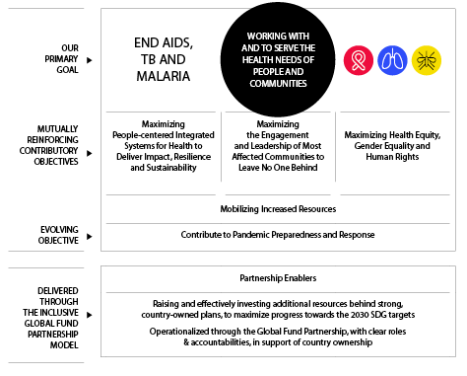
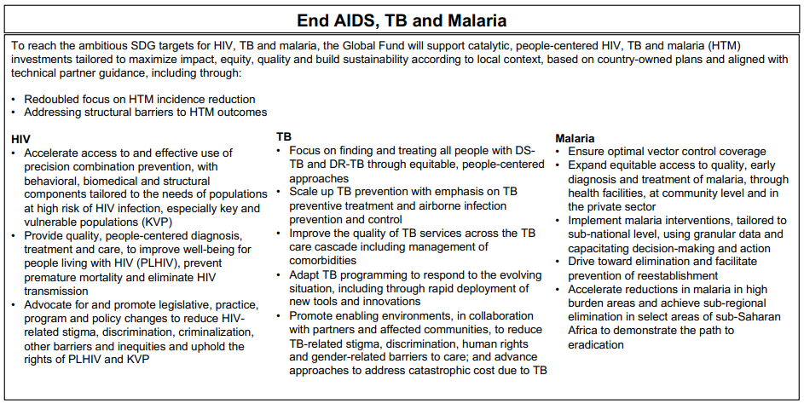
The Global Fund Strategy Framework
Primary Goal
Under the primary goal, there are sub-objectives (bullet points) that describe the specific areas focus needed to achieve this goal.
Notes:
As mentioned, the Strategy’s primary goal is to end AIDS, TB and malaria.
In order to do this, the Strategy has a particular focus on making catalytic, people-centered investments and leveraging innovations to spur faster progress in ending the three diseases.
You will see in the first two bullets at the top of the End AIDS, TB and Malaria slide that there is an overarching focus on incidence reduction and addressing structural barriers to HIV, TB and malaria outcomes, as these are two of the areas where greatest progress is needed to achieve our collective goals.
And for each of the 3 diseases, you will see that there are specific sub-objectives (the bullet points on this slide), to guide the focus of our partnership’s efforts in preventing, treating and caring for people living with and affected by HIV, TB and malaria.
[Tip for presenter: You may want to draw attention to particular sub-objectives of relevance to the audience.]

Slide 6
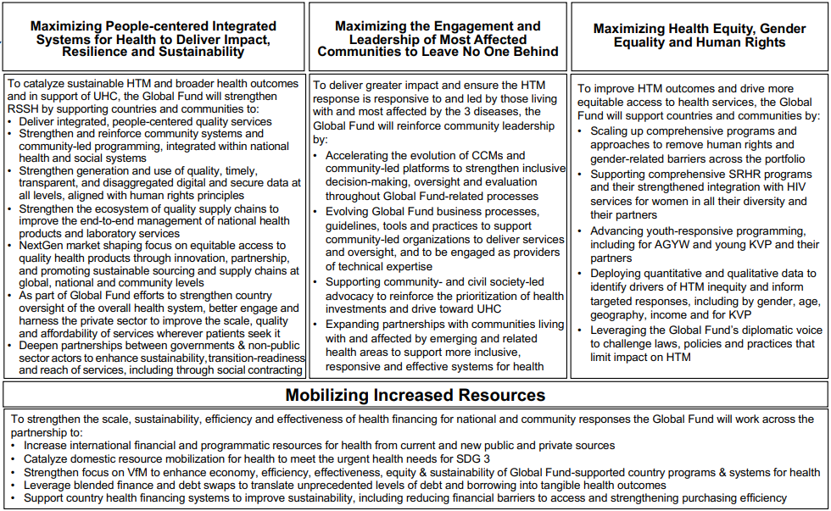
The Global Fund Strategy Framework
Mutually Reinforcing Contributory Objectives
Achievement of our primary goal will be underpinned by 4 mutually reinforcing contributory objectives that must be concurrently and synergistically pursued to achieve our aims.
Notes:
Achievement of the Strategy’s primary goal to end AIDS, TB and malaria is underpinned by four mutually reinforcing contributory objectives that must be concurrently and synergistically pursued to achieve our partnership’s aims.
As mentioned, the first is to Maximize People-centered Integrated Systems for Health. The Global Fund partnership will support RSSH investments that are catalytic according to the country’s context, that are people-centered and integrated across service providers to holistically address individuals’ health needs, and that build outcomes against HIV, TB and malaria, as well as related health areas such as the coinfections and comorbidities of the 3 diseases.
The second is to Maximize the Engagement and Leadership of Most Affected Communities to Leave No One Behind, to ensure balanced and inclusive decision-making around Global Fund resources and support communities to lead programs where they are best positioned to deliver impact and equity.
The third is to Maximize Health Equity, Gender Equality and Human Rights. It is critical for these key areas to be fully integrated as core lenses to Global Fund-supported programs to improve HIV, TB and malaria outcomes; to ensure investments are human rights-based and gender responsive; to drive more equitable access to and retention in health services; and ensure meaningful, lasting impact for all, including the most marginalized.
The fourth is to Mobilize Increased Resources – both domestic and additional international resources. Given the vast financial challenges globally stemming from COVID-19, innovation and effective tailoring of Global Fund co-financing requirements will be important to increase the resources needed to achieve our aims, as well as an increased focus on value for money (including equity) and the sustainability of Global Fund investments.
[Tip for presenter: For each of these Objectives, you may want to draw attention to particular sub-objectives of relevance to the audience.]

Slide 7
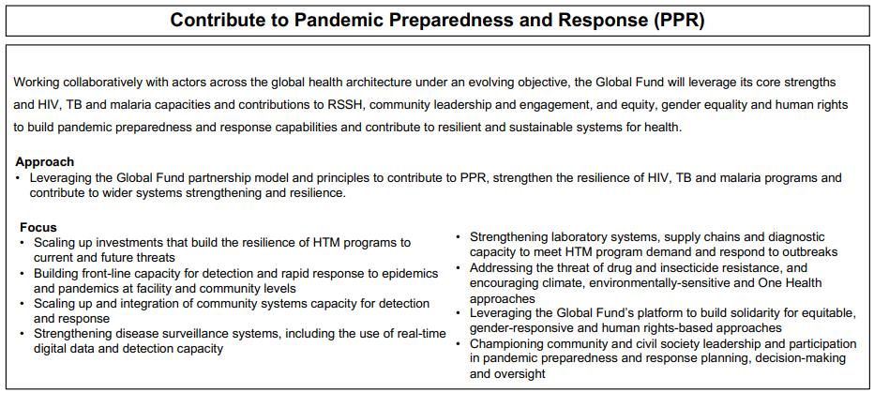
The Global Fund Strategy Framework
Evolving Objective
The new Strategy responds directly to the dramatic changes in the global health context by introducing an evolving objective on PPR.
We will bring the Global Fund partnership’s expertise and inclusive model to this global priority, alongside the important work with our partners.
We will contribute to building pandemic preparedness by supporting countries to strengthen the resilience of their systems for health and HTM programs.
Our work in pandemic response is well defined by our existing programs and C19RM.
Notes:
The new Strategy responds directly to dramatic changes in the global health context by introducing an evolving objective on pandemic preparedness and response (PPR).
This objective aims to bring the Global Fund partnership’s expertise and inclusive model to contribute to this global priority, alongside the important work of our partners.
The objective is described as ‘evolving’ because the Global Fund will need to remain agile to adapt over the Strategy term as the world and global health architecture continue to evolve in response to the global pandemic.
On pandemic preparedness, the Global Fund is uniquely positioned to support countries in strengthening their pandemic preparedness capabilities by building inclusive resilient and sustainable systems for health and HIV, TB and malaria programs, which are better able to prevent, detect and respond to new infectious disease threats.
The Global Fund will contribute to building countries’ pandemic preparedness capabilities through investments such as in strengthening laboratories, diagnostic tools, support for health care and peer workers, reinforcing community systems and efforts to tackle antimicrobial resistance, among other other areas.
The Global Fund is developing information and guidance on the scope of these investments in time for work to commence on the next cycle of grants that will start from 2024 onwards.
On pandemic response, the Global Fund’s work is already well defined by existing programs and C19RM, the Global Fund’s COVID-19 Response Mechanism, and the Global Fund will continue to mobilize resources distinctly for these efforts as applicable.

Slide 8
The Global Fund Strategy Framework
Partnership Enablers and M&E Framework
Partnership Enablers
The Global Fund model is based on the core principles of country ownership and partnership.
Achievement of the Strategy’s goal and objectives depends on the collaboration of all partners, working together, each with distinct, complementary roles and accountabilities.
These roles and accountabilities are described in the Partnership Enablers section of the Strategy.
Notes:
The Global Fund model is based on the core principles of country ownership and partnership, and so achievement of the Strategy’s goal and objectives depends on the collaboration of all partners, working together, each with distinct, complementary roles and accountabilities, to achieve to best results.
The roles and accountabilities of implementer governments, communities, civil society, technical and development partners, the private sector and others are described in the Partnership Enablers section of the Strategy.
This section of the Strategy also describes important areas where the partnership’s work needs to be strengthened to deliver the Strategy: from accelerating the equitable introduction and uptake of innovations; to better balancing financial and programmatic risks to create an enabling environment for achieving impact; to strengthening CCMs to ensure meaningful engagement of communities; and more.

Slide 9
The Global Fund Strategy
Monitoring and Evaluation Framework
The Global Fund M&E Framework to facilitate learning and accountability to drive impact of investments
Achievement of the Strategy’s aims is measured through a comprehensive and accountable Monitoring and Evaluation (M&E) Framework as well as through global partner plans and the SDG 3 goals and targets.
The M&E Framework links Strategy key performance indicators, a multi-year evaluation calendar, and grant and Secretariat monitoring to measure progress towards achieving the Strategy objectives.
STRATEGIC MONITORING
STRATEGIC
AND THEMATIC EVALUATION
STRATEGY
OUTCOMES
PROGRAM MONITORING
SECRETARIAT MONITORING
Informed and
completed by technical partner reports, studies,
and other evidence
Notes:
Achievement of the Strategy’s aims is measured through a comprehensive and accountable Monitoring and Evaluation (M&E) Framework, including key performance indicators, as well as through global partner plans and the SDG 3 goals and targets.
The objective of the M&E Framework is to facilitate performance management, continuous learning and improved decision-making by providing relevant, comprehensive, complete, and timely information to improve health program quality, efficiency, effectiveness, and therefore impact of Global Fund investments.
The M&E Framework includes 4 interrelated components; each component contains interlinked measurement frameworks, systems, and tools that generate data and evidence that serve different purposes and audiences across Global Fund grants and Strategy life cycles. Key frameworks and tools within the components include a Strategy key performance indicator framework, a multi-year evaluation calendar, grant performance frameworks and Secretariat monitoring systems.
Insights from partner reporting, research, and other evidence generation also inform and/or complement each component.
Collectively, information coming through the four components of the M&E Framework provides a comprehensive picture of progress towards achieving the Strategy outcomes and on how well the Global Fund is delivering on its mandate

Slide 10
What is different about this new Strategy?
1
Across all three diseases, an intensified focus on prevention.
6
Greater emphasis on programmatic and financial sustainability.
2
Greater emphasis on integrated, people-centered services.
7
Greater focus on accelerating the equitable deployment of and access to innovations.
3
A more systematic approach to supporting the development and integration of community systems for health.
8
Much greater emphasis on data-driven decision-making.
4
A stronger role and voice for communities living with and affected by the diseases.
9
Explicit recognition of the role the Global Fund partnership can and should play in pandemic preparedness and response.
5
Intensified action to address inequities, human rights and gender-related barriers.
10
Clarity on the roles and accountabilities of Global Fund partners across every aspect of the Strategy.
Notes:
A summary of the top 10 things that are new about the Strategy are shown in this box.
Achieving impact in these areas will require some of the biggest changes in what we focus on and how we work together as a partnership. These areas are will be an important focus in the of preparations to implementation of the new Strategy.
[Tip for presenter: Either say that you won't read through each of these areas as they have already been highlighted in the presentation/ say the audience read these areas in their own time and you will share the presentation with them/ read through the 10 areas very briefly.]

Slide 11


Next Steps
It is important for all stakeholders in the Global Fund partnership to consider which changes they can make to deliver our Strategy’s goals and objectives – as guided by the roles and accountabilities in the Partnership Enablers section.
The Secretariat has updated relevant policies, guidelines, materials and tools for the next cycle of grants that will commence in 2024.
We look forward to working together to achieve our vision of a world free of the burden of AIDS, TB and malaria with better, equitable health for all.
Resources
Global Fund Strategy (2023-2028): عربي| English | Español | Français | Português | Русский
Executive Summary: English | Español | Français | Italiano |日本語| Português | Русский | Deutsch | عربي | 中文
Strategy Framework: عربي | English | Español | Français | Português | Русский
M&E Framework: https://www.theglobalfund.org/en/monitoring-evaluation/
For more information please see: https://www.theglobalfund.org/en/strategy/
Notes:
It is now important for all stakeholders in the Global Fund partnership to consider which changes they can make to implement the new Strategy.
The Partnership Enablers section of the Strategy helps with this by describing the roles and accountabilities of all stakeholders in delivering the Strategy. We strongly encourage you to review the new Strategy document to help guide your role in its implementation.
The Secretariat has also updated relevant policies, guidelines, materials and tools, in time for the first cycle of grants under the new Strategy that will commence in 2024.
There are resources available to help with your preparations and in communicating the Strategy’s priorities to your stakeholder groups, such as this presentation, an Executive Summary document, the Strategy and an overview of its Framework - available on the Global Fund website in many languages – as shown at the bottom of the slide.
We look forward to working together to collectively harness our strengths to deliver the Strategy and achieve our partnership’s vision of a world free of the burden of AIDS, TB and malaria, with better, equitable health for all.

Slide 12
Annex
Tailored Next Steps slides for different stakeholder audiences.
(to be used in place of slide 11)
In the following section there are tailored slides that can be used with the following stakeholder audiences:
CCMs
Communities and Civil Society
Development Partners (bilateral and multilateral organizations that contribute resources and expertise)
Implementers
LFAs
Private Sector
Technical Partners

Slide 13
Next Steps: What does the new Strategy mean for CCMs?
CCMs play an important role in delivering the priorities of the Global Fund partnership’s new Strategy
Stronger CCM Governance
Ensuring balanced and inclusive decision making around use of Global Fund resources, especially the meaningful involvement of communities, including KPs.
Strengthening CCM positioning and alignment with national structures to strengthen effective implementation of the Strategy’s priorities (e.g., RSSH, PPR) and build sustainability.
Supporting decision-making around the Strategy’s new priorities
Communicating the Strategy’s priorities to stakeholders and ensuring they are embedded in grants and Global Fund lifecycle processes.
Promoting new partnerships (e.g., multi-sector to address structural barriers to HTM outcomes, with PPR or private sector stakeholders) and new linkages (e.g., to build integrated, people-centered, quality services) to deliver the Strategy’s aims.
Considering CCM membership adjustments to bring in relevant new expertise.
Resources
Global Fund Strategy (2023-2028): عربي| English | Español | Français | Português | Русский
Executive Summary: English | Español | Français | Italiano |日本語| Português | Русский | Deutsch | عربي | 中文
Strategy Framework: عربي | English | Español | Français | Português | Русский
M&E Framework: https://www.theglobalfund.org/en/monitoring-evaluation/
Contact: ccm@theglobalfund.org or for more information please see: https://www.theglobalfund.org/en/strategy/
Notes:
CCMs play an important role in delivering the priorities of the Global Fund partnership’s new Strategy.
In relation to stronger CCM Governance:
An important area of focus in the new Strategy is strengthening CCMs to enable balanced and inclusive decision-making around use of Global Fund resources – in particular to ensure that communities, including key populations, are fully engaged and can play an equal role in decision making.
This is critical to ensure that communities guide how programs can be tailored to best meet their needs, and therefore improve the effectiveness of programs.
The Strategy also places emphasis on the importance of accelerating the optimal positioning and alignment of CCMs at the highest level of decision making within national structures and existing governance bodies.
This is important to support the effective implementation of the Strategy’s priorities such as in delivering integrated, people-centered quality services, supporting pandemic preparedness, as well as to build the longer-term sustainability of Global Fund programs, while safeguarding core principles such as inclusion, transparency and rights.
In relation to supporting decision making around the Strategy’s new priorities:
The new Strategy is a lot more specific about the priority areas where Global Fund resources and the partnership’s efforts should be focused, to improve program quality and accelerate the pace of implementation towards the 2030 goals.
The CCM will play a key role in communicating the new Strategy’s priorities to country stakeholders and in guiding grant lifecycle processes - such as drafting funding requests, nominating PRs and SRs, making grants, monitoring and course correcting programs - to support a focus on these key areas to have the greatest impact.
The CCM also has an important role in promoting new partnerships and linkages to deliver the Strategy’s priorities, such as:
working with relevant national sectors such as education and social protection to address structural determinants of HTM outcomes and increase access to high quality health services for key populations,
working with pandemic preparedness stakeholders to ensure that Global Fund resources are effectively used to address multi-pathogen infectious disease threats beyond HTM,
as relevant to the implementation context, engaging the private sector to strengthen program outcomes where people seek care in the private sector, and
making new linkages, for example with stakeholders across the health sector and between national, community and private sector health providers - to ensure that Global Fund resources are programmed in a way that supports integrated people-centered quality services.
To ensure that CCMs have the expertise needed to deliver programs in these areas, it will also be important to consider temporary or permanent membership adjustments (such as by updating bylaws and sub-committees) to bring in relevant stakeholders and experts on new areas or those areas with deeper emphasis under the new Strategy.
Resources
There are a number of resources available to help CCMs communicate the Strategy’s priorities to your stakeholders, such as this presentation, an Executive Summary document, the Strategy itself and an overview of its Framework – these are all available on the Global Fund website in many languages – as shown at the bottom of the slide.
We look forward to working together to collectively harness our strengths to deliver the Strategy and achieve our partnership’s vision of a world free of the burden of AIDS, TB and malaria, with better, equitable health for all.

Slide 14
Next Steps: What does the new Strategy mean for Communities and Civil Society?
Communities and Civil Society play an important role in delivering the Global Fund partnership’s new Strategy
Contributing to CCM decision making to ensure programs are best positioned to deliver the Strategy’s priorities and meet the needs of communities, incl. KVP and under-represented populations.
Leading programs where communities or civil society are best positioned to meet individuals’ needs – at PR, SR, SSR and grassroots levels.
Highlighting the importance of community-led monitoring and technical support provided by communities and civil society in guiding effective program implementation.
Strengthening community systems and partnering with government, private and other healthcare providers to integrate services and provide people-centered care.
Supporting collaboration across sectors and addressing harmful laws, policies and practices to tackle structural determinants of HTM outcomes, including human rights barriers, gender-related barriers and inequities, and promoting youth/ young-KP responsive programs.
Building new community and civil society partnerships to deliver the Strategy, incl. with disability and mental health communities, those integral to pandemic preparedness.
Resources
Global Fund Strategy (2023-2028): عربي| English | Español | Français | Português | Русский
Executive Summary: English | Español | Français | Italiano |日本語| Português | Русский | Deutsch | عربي | 中文
Strategy Framework: عربي | English | Español | Français | Português | Русский
M&E Framework: https://www.theglobalfund.org/en/monitoring-evaluation/
For more information please see: https://www.theglobalfund.org/en/strategy/
Notes:
Communities and Civil Society play an important role in delivering the priorities of the Global Fund partnership’s new Strategy.
Indeed, communities are at the center of this new Strategy, as those most affected by the three diseases are best positioned to guide how programs can best meet their needs, and in a number of cases are also best positioned to implement and monitor the impact of programs, such as those for key and vulnerable populations.
The role of communities and civil society in the delivery of the next Strategy includes:
Contributing to CCM decision making throughout the grant lifecycle to ensure that programs are best positioned to deliver the Strategy’s priorities and meet the needs of people and communities, including those of key and vulnerable populations and under-represented populations.
Leading programs as implementers where communities or civil society are best positioned to meet individuals’ needs – at the PR, SR, SSR and grassroots levels.
Highlighting the importance of community-led monitoring to strengthen oversight and accountability for results, and the importance of technical support provided by communities and civil society to guide effective program implementation.
Strengthening community systems and partnering with government, private and other healthcare providers to integrate services to provide people-centered care that holistically addresses individuals’ health needs, including across HTM coinfections and comorbidities and related health areas such as sexual and reproductive health and rights.
Supporting collaboration across sectors and addressing harmful laws, policies and practices to tackle structural determinants of HTM outcomes, including human rights barriers (such as stigma and discrimination), gender-related barriers and inequities, and to promote youth- and young-KP-responsive programs.
Proactively building new community and civil society partnerships to deliver the Strategy, including with those representing the disability and mental health communities, as well as those integral to discussions on pandemic preparedness.
Resources
There are a number of resources available to help with this and in communicating the Strategy’s priorities to your stakeholders, such as this presentation, an Executive Summary document, the Strategy itself and an overview of its Framework – these are all available on the Global Fund website in many languages – as shown at the bottom of the slide.
We look forward to working together to collectively harness our strengths to deliver the Strategy and achieve our partnership’s vision of a world free of the burden of AIDS, TB and malaria, with better, equitable health for all.

Slide 15
Next Steps: What does the new Strategy mean for Development Partners?
Development Partners¹ play an important role in delivering the Global Fund partnership’s new Strategy
Aligning support behind robust country plans and common priorities, for example, on investments in integrated, people-centered quality services and data systems, or addressing structural determinant of HTM outcomes.
Collaborating on leveraging increased domestic and additional donor funds, driving greater VfM and sustainable health impact, including through participation in and co-financing of blended finance and innovative finance models.
Earlier collaboration to help seed and scale up effective innovations, incl. through targeted investments, guarantees and market shaping efforts.
Contributing to the Global Fund partnership’s diplomatic voice in challenging harmful laws, policies and practices.
Resources
Global Fund Strategy (2023-2028): عربي| English | Español | Français | Português | Русский
Executive Summary: English | Español | Français | Italiano |日本語| Português | Русский | Deutsch | عربي | 中文
Strategy Framework: عربي | English | Español | Français | Português | Русский
M&E Framework: https://www.theglobalfund.org/en/monitoring-evaluation/
For more information please see: https://www.theglobalfund.org/en/strategy/
¹ Encompasses bilateral and multilateral organizations that contribute resources and expertise (and often on the ground implementation capacity), including donors to the Global Fund, donors with bilateral programs and organizations that contribute expertise. Development partners do not include technical partners of the Global Fund, which are their own stakeholder category.
Notes:
In the Global Fund context, Development Partners are bilateral and multilateral organizations that contribute resources and expertise in delivering the new Strategy. They include donors to the Global Fund, donors with bilateral programs and organizations that contribute expertise on the ground and at global and regional levels. They do not include technical partners of the Global Fund, which are their own stakeholder category.
Development Partners play an important role in delivering the priorities of the Global Fund partnership’s new Strategy.
The role of Development Partners in the delivery of the next Strategy includes:
Aligning support behind robust country plans and common priorities, for example, on investments in integrated, people-centered quality services and data systems, or addressing structural determinants of HTM outcomes.
Collaborating on leveraging increased domestic and additional donor funds, driving greater value for money and sustainable health impact, including through participating in and co-financing of blended finance and innovative finance models.
Earlier and greater collaboration in helping to seed and scale up effective innovations, including through targeted investments, guarantees and market shaping efforts.
Contributing to the Global Fund partnership’s diplomatic voice in challenging harmful laws, policies and practices.
Resources
There are a number of resources available to help with this and in communicating the Strategy’s priorities to your stakeholder groups, such as this presentation, an Executive Summary document, the Strategy itself and an overview of its Framework – these are all available on the Global Fund website in many languages – as shown at the bottom of the slide.
We look forward to working together to collectively harness our strengths to deliver the Strategy and achieve our partnership’s vision of a world free of the burden of AIDS, TB and malaria, with better, equitable health for all.

Slide 16
Next Steps: What does the new Strategy mean for Implementers?
Implementers play an important role in delivering the priorities of the Global Fund partnership’s new Strategy
Designing and implementing country-led plans to deliver quality programs that efficiently, effectively and equitably deliver the Strategy’s HTM sub-objectives, build integrated people-centered quality services, maximize the engagement of most affected communities, maximize equity, human rights and gender equality, and build PPR.
Mobilizing increased domestic resources for health and the three diseases and strengthening the focus on quality and VfM.
Promoting new partnerships (e.g., multi-sector to address structural barriers, with PPR or private sector stakeholders) and new linkages (e.g., to build integrated, people-centered, quality services) to deliver the Strategy’s aims.
Creating an enabling environment for innovations and ensuring equitable access to them.
Ensuring meaningful engagement of communities, including KP, and other relevant experts in the design, delivery and monitoring of services.
Contributing to the Global Fund partnership’s diplomatic voice in challenging harmful laws, policies and practices.
Resources
Global Fund Strategy (2023-2028): عربي| English | Español | Français | Português | Русский
Executive Summary: English | Español | Français | Italiano |日本語| Português | Русский | Deutsch | عربي | 中文
Strategy Framework: عربي | English | Español | Français | Português | Русский
M&E Framework: https://www.theglobalfund.org/en/monitoring-evaluation/
Contact: Your country’s Fund Portfolio Manager (FPM) or for more information please see: https://www.theglobalfund.org/en/strategy/
Notes:
Implementers are the organizations and governments that implement Global Fund-supported programs, and they play an important role in delivering the priorities of the Global Fund partnership’s new Strategy.
The role of implementers in the delivery of the next Strategy includes:
Designing and implementing country-led plans to deliver quality programs that efficiently, effectively and equitably deliver the Strategy’s HIV, TB and malaria sub-objectives, build integrated people-centered quality services, maximize the engagement of most affected communities, maximize equity, human rights and gender equality, and build pandemic preparedness.
Mobilizing increased domestic resources for health and the three diseases to build the sustainability and reach of programs, as well as strengthening the focus on quality and value for money in national strategic plans and program design and implementation.
Strengthening collaboration between relevant sectors and expertise providers, and building new linkages, e.g. to address structural barriers to HTM outcomes, to integrate national health, community, private sector and other systems for health and ensure services are people-centered, or to deliver pandemic preparedness aims.
Creating an enabling environment for innovations and ensuring equitable access to new approaches, in order improve program outcomes.
Ensuring meaningful engagement of communities, including key populations, and other relevant actors and experts in the design, delivery and monitoring of services to ensure they are best positioned to meet people’s needs.
And by contributing to the Global Fund partnership’s diplomatic voice in challenging harmful laws, policies and practices.
Resources
There are a number of resources available to help with this and in communicating the Strategy’s priorities to your stakeholders, such as this presentation, an Executive Summary document, the Strategy itself and an overview of its Framework – these are all available on the Global Fund website in many languages – as shown at the bottom of the slide.
We look forward to working together to collectively harness our strengths to deliver the Strategy and achieve our partnership’s vision of a world free of the burden of AIDS, TB and malaria, with better, equitable health for all.

Slide 17
Next Steps: What does the new Strategy mean for LFAs?
LFAs play an important role in delivering the priorities of the Global Fund partnership’s new Strategy
Assisting the Global Fund in ensuring effective and efficient program implementation to deliver the Strategy’s priorities.
Promoting new partnerships (e.g., multi-sector to address structural barriers, with PPR or private sector stakeholders) and new linkages (e.g., for integrated, people-centered, quality services) to deliver the Strategy’s aims.
Helping to monitor the meaningful engagement of all stakeholders in CCM decision making throughout the grant lifecycle, especially communities, including KP.
Helping to promote an enabling environment for innovation to accelerate delivery of the Strategy’s aims
Resources
Global Fund Strategy (2023-2028): عربي| English | Español | Français | Português | Русский
Executive Summary: English | Español | Français | Italiano |日本語| Português | Русский | Deutsch | عربي | 中文
Strategy Framework: عربي | English | Español | Français | Português | Русский
M&E Framework: https://www.theglobalfund.org/en/monitoring-evaluation/
Contact: lfacoordinationteam@theglobalfund.org or for more information please see: https://www.theglobalfund.org/en/strategy/
Notes:
LFAs play an important role in delivering the priorities of the Global Fund partnership’s new Strategy.
The role of LFAs in the delivery of the next Strategy includes:
Assisting the Global Fund in ensuring effective and efficient program implementation to deliver the Strategy’s priorities.
Promoting the strengthening of partnerships between relevant sectors and expertise providers, and the building of new linkages, e.g. to address structural barriers to HTM outcomes, to integrate national health, community, private sector and other systems for health and to ensure services are people-centered, or to deliver our pandemic preparedness aims.
Helping to monitor the meaningful engagement of all stakeholders in CCM decision making throughout the grant lifecycle, especially communities, including key populations.
Helping to promote an enabling environment for innovation to accelerate delivery of the Strategy’s aims.
Resources
There are a number of resources available to help with this and in communicating the Strategy’s priorities to your stakeholder groups, such as this presentation, an Executive Summary document, the Strategy itself and an overview of its Framework – these are all available on the Global Fund website in many languages – as shown at the bottom of the slide.
We look forward to working together to collectively harness our strengths to deliver the Strategy and achieve our partnership’s vision of a world free of the burden of AIDS, TB and malaria, with better, equitable health for all.

Slide 18
Next Steps: What does the new Strategy mean for the Private Sector?
The Private Sector plays an important role in delivering the priorities of the Global Fund partnership’s new Strategy
Country-level service providers
Strengthening health outcomes through improved service quality and access to affordable, cost-effective, equitable, rights-based health services.
Working with national, community and other healthcare providers to integrate services and related data to deliver people-centered quality care.
Technical support and capability providers
Supporting national/ regional capacity in areas such as lab services, supply chain, technology services, digital health, logistics - ensuring alignment with national standards.
Product developers, manufacturers and suppliers
Developing new and more effective diagnostics, drugs, treatment regimens and vaccines, and supporting the equitable availability of affordable innovations.
Engaging the partnership on relevant product pipelines, timelines and pricing.
Private donors
Increasing financial/ non-financial contributions and supporting innovative financing.
Resources
Global Fund Strategy (2023-2028): عربي| English | Español | Français | Português | Русский
Executive Summary: English | Español | Français | Italiano |日本語| Português | Русский | Deutsch | عربي | 中文
Strategy Framework: عربي | English | Español | Français | Português | Русский
M&E Framework: https://www.theglobalfund.org/en/monitoring-evaluation/
Contact privatesector@theglobalfund.org or for more information please see: https://www.theglobalfund.org/en/strategy/
Notes:
The Private Sector plays an important role in delivering the priorities of the Global Fund partnership’s new Strategy.
Achieving our goal of ending AIDS, TB and Malaria will require improving the equitable access to quality, affordable services wherever people seek care. In a number of important contexts, a significant amount of care is sought through the private sector.
As such, improved engagement, contracting and coordination with country-level private sector service providers will be critical in:
Strengthening health outcomes through improved quality and access to affordable, cost-effective, equitable, rights-based health services, aligned with national quality standards and assurance mechanisms.
Working with national, community and other healthcare providers to integrate services and related data to deliver people-centered quality care that meets individuals’ health needs.
Technical support and capability providers can support this by:
Providing quality support and capabilities to strengthen national and regional capacity in areas such as laboratory services, supply chain, technology services, digital health, logistics - ensuring alignment with national standards, latest effective innovations and integrated within national systems.
The private sector also plays an important role in innovation and scaling innovative solutions, which will be crucial in accelerating impact. Product developers, manufacturers, and suppliers can therefore support this by:
Developing new and more effective diagnostics, drugs, treatment regimens and vaccines, and supporting the equitable availability at scale of affordable products and innovations.
Engaging the partnership on relevant product pipelines, timelines and pricing for rapid introduction and equitable scale up; and ensuring a robust supply chain of quality products with appropriate lifespans.
And, of course, private donors can support this and overall achievement of the Strategy by:
Increasing financial and non-financial contributions and supporting innovative financing models.
Resources
There are a number of resources available to help with this and in communicating the Strategy’s priorities to your stakeholder groups, such as this presentation, an Executive Summary document, the Strategy itself and an overview of its Framework – these are all available on the Global Fund website in many languages – as shown at the bottom of the slide.
We look forward to working together to collectively harness our strengths to deliver the Strategy and achieve our partnership’s vision of a world free of the burden of AIDS, TB and malaria, with better, equitable health for all.

Slide 19
Next Steps: What does the new Strategy mean for Technical Partners?
Technical Partners play an important role in delivering the priorities of the Global Fund partnership’s new Strategy
Developing new and timely revisions of normative and prioritization guidance based on the latest available evidence to guide more effective programming.
Supporting translation of technical guidelines into effective implementation at country-level, by developing effective tools that can be tailored to country context and linked to measurable outcomes
Strengthening technical support and capacity building based on a country-led description of needs and strengthen quality standards for support.
Supporting the generation and communication of updates on operational research, evidence and best practices to accelerate the Strategy’s delivery, and support country readiness for introduction of innovations.
Supporting countries in strengthening national data systems and effective use of data for decision making at all levels.
Supporting effective partnerships between government and non-public sector actors and contributing to the Global Fund partnership’s diplomatic voice in challenging harmful laws, policies and practices.
Resources
Global Fund Strategy (2023-2028): عربي| English | Español | Français | Português | Русский
Executive Summary: English | Español | Français | Italiano |日本語| Português | Русский | Deutsch | عربي | 中文
Strategy Framework: عربي | English | Español | Français | Português | Русский
M&E Framework: https://www.theglobalfund.org/en/monitoring-evaluation/
For more information please see: https://www.theglobalfund.org/en/strategy/
Notes:
Technical Partners play an important role in delivering the priorities of the Global Fund partnership’s new Strategy.
The role of Technical Partners in the delivery of the next Strategy includes:
Developing new and timely revisions of normative and prioritization guidance based on the latest available evidence to guide more effective programming, including for HIV prevention, malaria, newer areas of Strategy focus and on relevant areas of private sector engagement, governance and quality standards.
Supporting the translation of technical guidelines into effective implementation at country-level, by developing effective tools that can be tailored to country context and linked to measurable outcomes – for example, to support bringing innovations and effective service delivery models to scale, or to support implementation of the International Health Regulations.
Strengthening technical support and capacity building based on a country-led description of needs and strengthening quality standards for technical support and capacity building, including timeliness, alignment, transparency and accountability.
Supporting the generation and communication of updates on operational research, evidence and best practices to strengthen HTM responses and to implement robust integrated, people-centered quality services, as well as supporting country readiness for introduction of new health products and innovations.
Supporting countries in strengthening national data systems and effective use of data for decision making at all levels, including a focus on data collection, digital tools, quality assurance, analysis, interpretation and use.
Supporting effective partnerships between government and non-public sector actors, and contributing to the Global Fund partnership’s diplomatic voice in challenging harmful laws, policies and practices.
Resources
There are a number of resources available to help with this and in communicating the Strategy’s priorities to your stakeholder groups, such as this presentation, an Executive Summary document, the Strategy itself and an overview of its Framework – these are all available on the Global Fund website in many languages – as shown at the bottom of the slide.
We look forward to working together to collectively harness our strengths to deliver the Strategy and achieve our partnership’s vision of a world free of the burden of AIDS, TB and malaria, with better, equitable health for all.

